Slide 1
Linear regression math
Using python

Slide 2
Importance of linear regression
Linear-regression models have become a proven way to scientifically and reliably predict the future. Because linear regression is a long-established statistical procedure, the properties of linear-regression models are well understood and can be trained very quickly.

Slide 3
Assumptions to be considered for success with linear-regression analysis:
For each variable: Consider the number of valid cases, mean and standard deviation.
For each model: Consider regression coefficients, correlation matrix, part and partial correlations, multiple R, R2, adjusted R2, change in R2, standard error of the estimate, analysis-of-variance table, predicted values and residuals.
Plots: Consider scatterplots, partial plots, lineplot .
Data: Dependent and independent variables should be quantitative. Categorical variables, such as religion, major field of study or region of residence, need to be recoded to binary (dummy) variables or other types of contrast variables.
Other assumptions: For each value of the independent variable, the distribution of the dependent variable must be normal. The variance of the distribution of the dependent variable should be constant for all values of the independent variable

Slide 4

Finding the best fit line
Least squares is a statistical method used to determine the best fit line or the regression line by minimizing the sum of squares created by a mathematical function. The “square” here refers to squaring the distance between a data point and the regression line. The line with the minimum value of the sum of square is the best-fit regression line.
Regression Line, y = mx+c where,
y = Dependent Variable
x= Independent Variable ;
c = y-Intercept

Slide 5
Understanding Linear Regression in Python
Linear regression is a statistical model used to predict the relationship between independent and dependent variables by examining two factors:
Which variables, in particular, are significant predictors of the outcome variable?
How significant is the regression line in terms of making predictions with the highest possible accuracy?
To understand the terms “dependent” and “independent variable,” let’s take a real-world example. Imagine that we want to predict future crop yields based on the amount of rainfall, using data regarding past crops and rainfall amounts.
Independent Variable
The value of an independent variable does not change based on the effects of other variables. An independent variable is used to manipulate the dependent variable. It is often denoted by an “x.” In our example, the rainfall is the independent variable because we can’t control the rain, but the rain controls the crop—the independent variable controls the dependent variable.

Slide 6
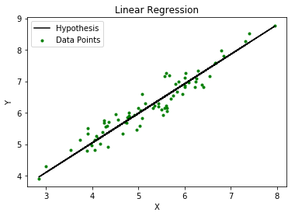
Linear Regression
In simple linear regression, we have the equation:
y = m*x + c
.
Cost function-
Cost function optimizes the regression coefficients or weights. It measures how a linear regression model is performing.
For Linear Regression, we use the Mean Squared Error (MSE) cost function

Slide 7

Mean Squared Error (MSE)
For the above linear equation, MSE can be calculated as:
Where,
N=Total number of observation Yi = Actual value (a1x_{i}+a₀)= Predicted value.

Slide 8
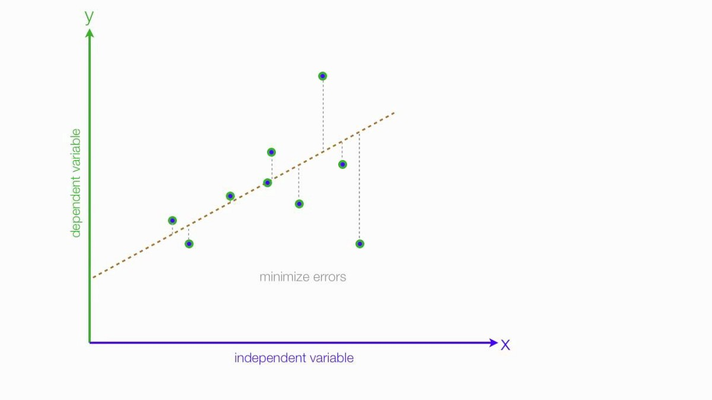
Bestfit line
Cost Function

Slide 9
Python Packages for Linear Regression:
NumPy : is a fundamental Python scientific package that allows many high-performance operations on single- and multi-dimensional arrays. It also offers many mathematical routines.
Ued in : Statistical Computing, Signal Processing, Graphs and Networks
scikit-learn is a widely used Python library for machine learning, built on top of NumPy and some other packages. It provides the means for preprocessing data, reducing dimensionality, implementing regression, classification, clustering, and more. Like NumPy, scikit-learn is also open source.
Used in :Machine Learning ,Model Accurancy

Slide 10
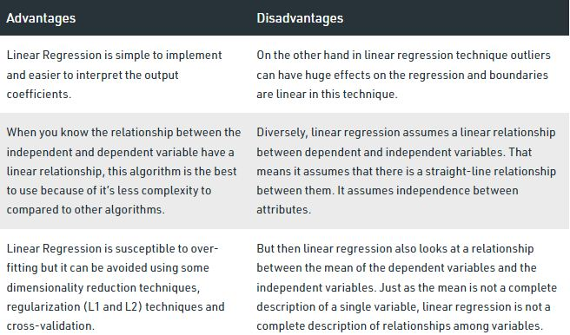

Slide 11
Group members- 1) yash s. subhedar(19UET046) 2) sanket v. suryavanshi(19UET047) 3) prashik k. gavali(19UET055) THANKS!

